Slide 1

Discovering a Global Data Model from Event Logs
Kim-Pascal Borchart
BPI @ HPI
Summer 2021

Slide 2
Agenda
Write your first topic here
Write your second topic here
Highlight your topics by using bold font (change manually)
Write your fourth topic here
If you need further details
Choose the second text layer

Slide 3
Recap - Model Discovery on Single Event Log
Start
Attr_1
Bano, Dorina & Weske, Mathias. (2020). Discovering Data Models from Event Logs
Case | Activity | Time | Attr_1 | Attr_2 | Attr_3
1 | Start | 1 | True |  | hello
1 | Do | 2 |  | 9.001
2 | Start | 3 | False |  | hi
2 | Do | 4 |  | 8.999
1 | Finish | 4 | False |  | bye
2 | Finish | 5 | True |  | see you
3 | Start | 6 | False |  | howdy!
Do
Attr_2
Finish
Attr_3
1
Attr_1 Attr_3
2
Attr_2

Slide 4
Recap - Problem Definition
Multiple event logs => One data model
Case | Activity | Time | Attr_1 | Attr_2 | Attr_3
1 | Start | 1 | True |  | hello
1 | Do | 2 |  | 9.001
2 | Start | 3 | False |  | hi
2 | Do | 4 |  | 8.999
1 | Finish | 4 | False |  | bye
2 | Finish | 5 | True |  | see you
3 | Start | 6 | False
1
Attr_1 Attr_3
?
2
Attr_2
Case | Activity | Time | Attr_1 | Attr_2 | Attr_3
1 | Start | 1 | True |  | hello
1 | Do | 2 |  | 9.001
2 | Start | 3 | False |  | hi
2 | Do | 4 |  | 8.999
1 | Finish | 4 | False |  | bye
2 | Finish | 5 | True |  | see you
3 | Start | 6 | False
N
Attr_n-2 Attr_n-1 Attr_n

Slide 5
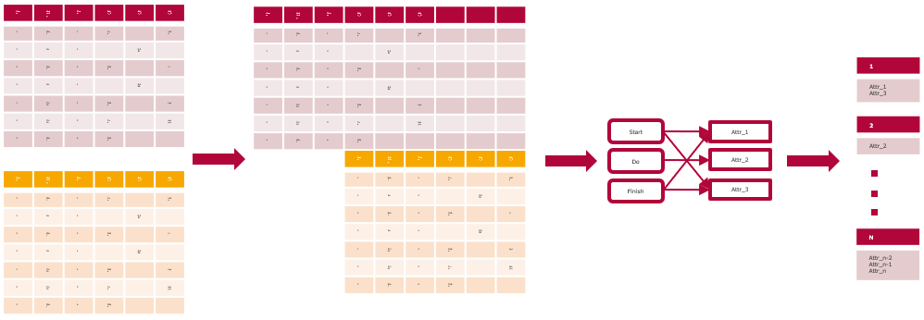
Recap – „Naive“ Approach

Slide 6
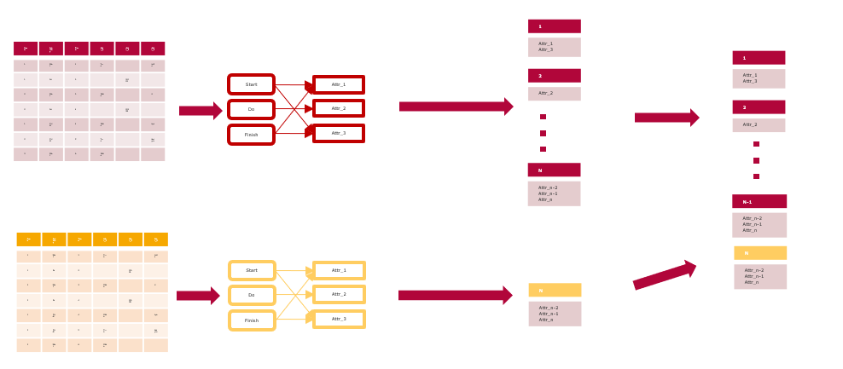
Approach – „Naive“ v2

Slide 7
A2A Diagrams - Example
Access
Att1
A
Att2
B
Activities
Attributes
Att3
C
Att4

Slide 8
A2A Diagrams - Example
Att1
A
Att2
B
Att3
C
Att4

Slide 9
A2A Diagrams - Example
Att1
A
Att2
B
Att3
Attr4

Slide 10
A2A Diagrams – Data Structure
A
x
Att1
x
y
Att2
B
x
y
Att3
C
x
Att4
 | Att1 | Att2 | Att3 | Att4
A | x | x | 0 | 0
B | y | x | y | 0
C | 0 | 0 | 0 | x

Slide 11
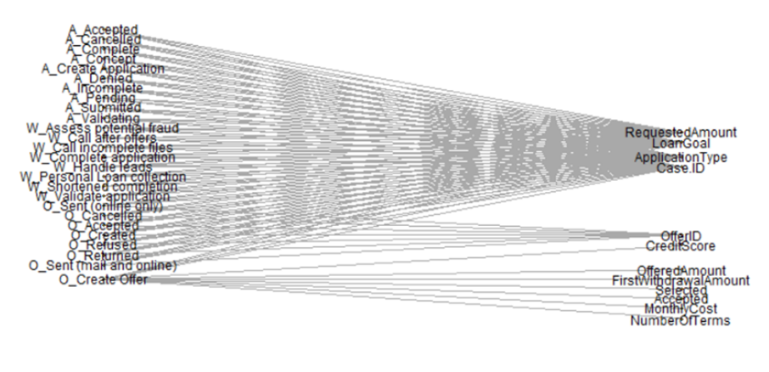
A2A Diagrams – Real World Example
A2A diagram for one BPI challenge 2017 event log

Slide 12
Intermission: Dataset – BPI Challenge 2017
Two event logs
OfferApplications: 1160405 events, 13 attributes
Offers: 193849 events, 11 attributes

Slide 13
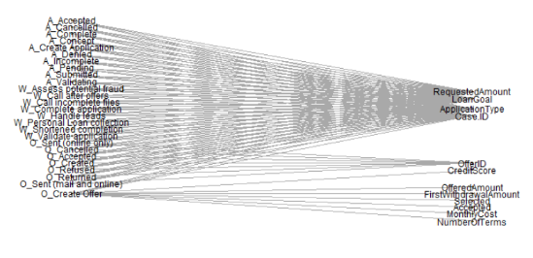
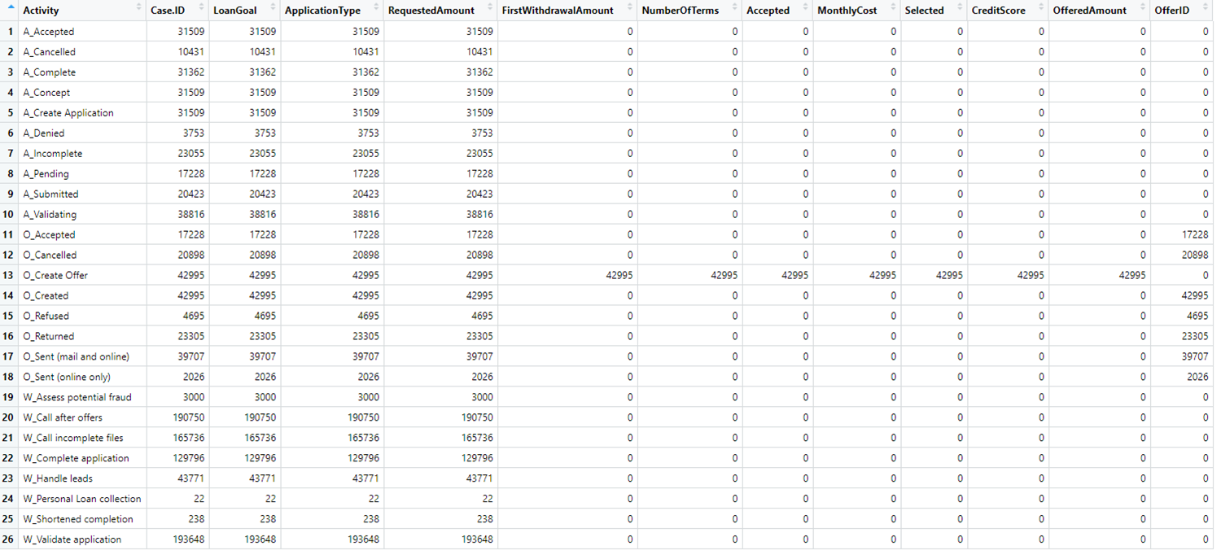
A2A Diagrams – Data Structure

Slide 14
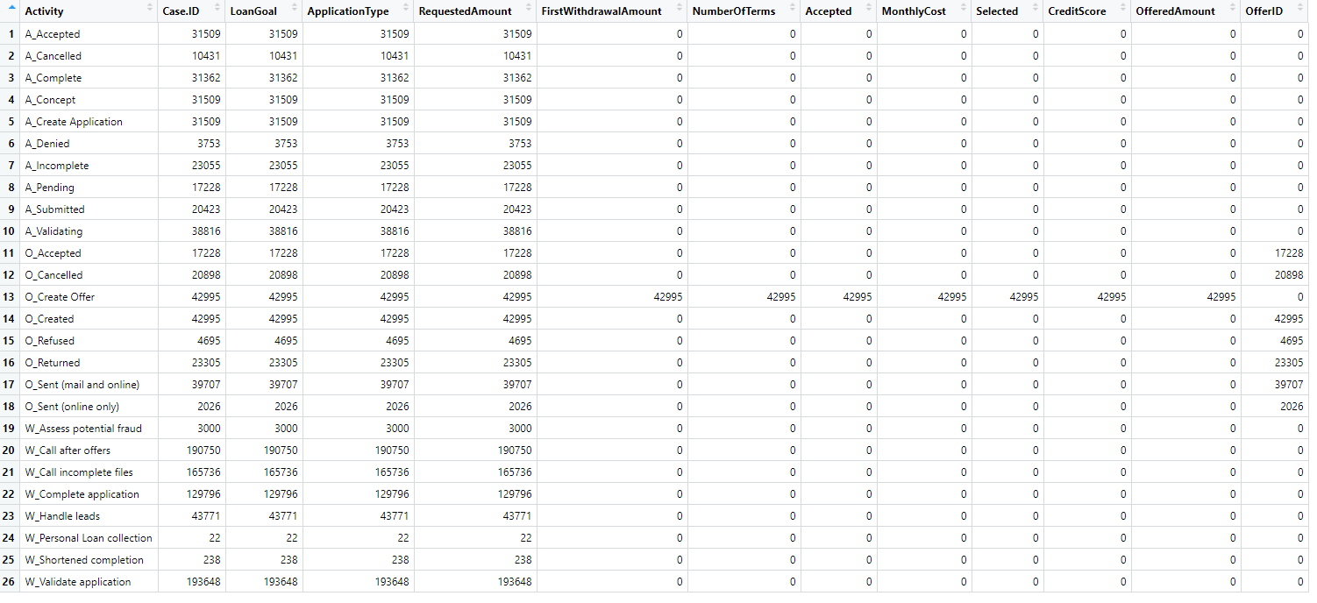
Underlying Model – Which Attributes Belong Together?

Slide 15
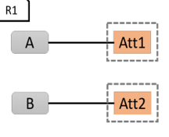
Underlying Model – Which Attributes Belong Together?
Activity | Att1 | Att2 | Att3 | Att4 | Att5 | Att6 | Att7
A |  |  |  |  | 0
B | 0 | 0 | 0 | 0 | x | 0 | 0
C |  |  |  |  | 0
D |  |  |  |  | 0
E |  |  |  |  | 0
Rule 1

Slide 16
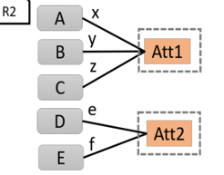
Underlying Model – Which Attributes Belong Together?
Activity | Att1 | Att2 | Att3 | Att4 | Att5 | Att6 | Att7
A |  |  |  |  | 0
B | 0 | 0 | 0 | 0 | x | 0 | 0
C |  |  |  |  | 0
D |  |  |  |  | 0
E |  |  |  |  | 0
Activity | Att1 | Att2 | Att3 | Att4 | Att5 | Att6 | Att7
A |  |  |  |  | 0
B | 0 | 0 | 0 | 0 | x | 0 | 0
C | 0 | 0 | 0 | 0 | x | 0 | 0
D | 0 | 0 | 0 | 0 | x | 0 | 0
E |  |  |  |  | 0
Rule 2

Slide 17
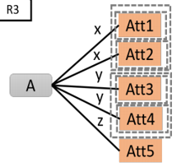
Underlying Model – Which Attributes Belong Together?
Activity | Att1 | Att2 | Att3 | Att4 | Att5 | Att6 | Att7
A |  |  |  |  | 0
B | 0 | 0 | 0 | 0 | x | 0 | 0
C |  |  |  |  | 0
D |  |  |  |  | 0
E |  |  |  |  | 0
Activity | Att1 | Att2 | Att3 | Att4 | Att5 | Att6 | Att7
A |  |  | 0 | 0 | 0
B | 0 | 0 | x | x | x | 0 | 0
C |  |  | 0 | 0 | 0
D |  |  | 0 | 0 | 0
E |  |  | 0 | 0 | 0
Rule 3

Slide 18
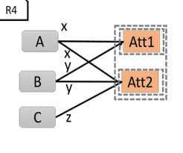
Underlying Model – Which Attributes Belong Together?
Activity | Att1 | Att2 | Att3 | Att4 | Att5 | Att6 | Att7
A |  |  |  |  | 0
B | 0 | 0 | 0 | 0 | x | 0 | 0
C |  |  |  |  | 0
D |  |  |  |  | 0
E |  |  |  |  | 0
Activity | Att1 | Att2 | Att3 | Att4 | Att5 | Att6 | Att7
A | z | 0 | 0 | m | n | z | 0
B | y | y | x | x | x | 0 | z
C | 0 | x | 0 | z | 0 | y | x
D | x | 0 | 0 | 0 | y | z | 0
E | 0 | y | 0 | x | 0 | 0 | x
Rule 4

Slide 19
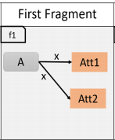
Underlying Model – Which Attributes Belong Together?
Activity | Att1 | Att2 | Att3 | Att4 | Att5 | Att6 | Att7
A |  |  |  |  | 0
B | 0 | 0 | 0 | 0 | x | 0 | 0
C |  |  |  |  | 0
D |  |  |  |  | 0
E |  |  |  |  | 0
Activity | Att1 | Att2 | Att3 | Att4 | Att5 | Att6 | Att7
A | z | 0 | 0 | m | n | z | 0
B | y | y | x | x | x | 0 | z
C | 0 | x | 0 | z | 0 | y | x
D | x | 0 | 0 | 0 | y | z | 0
E | 0 | y | 0 | x | 0 | 0 | x
Activity | Att1 | Att2 | Att3 | Att4 | Att5 | Att6 | Att7
A | z | 0 | 0 | m | n | z | 0
B | y | y | x | x | x | 0 | z
C | 0 | x | 0 | z | 0 | y | x
D | x | 0 | 0 | 0 | y | z | 0
E | 0 | y | 0 | x | 0 | 0
Rule 4

Slide 20
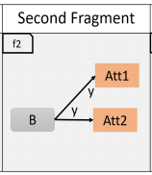
Underlying Model – Which Attributes Belong Together?
Activity | Att1 | Att2 | Att3 | Att4 | Att5 | Att6 | Att7
A |  |  |  |  | 0
B | 0 | 0 | 0 | 0 | x | 0 | 0
C |  |  |  |  | 0
D |  |  |  |  | 0
E |  |  |  |  | 0
Activity | Att1 | Att2 | Att3 | Att4 | Att5 | Att6 | Att7
A | z | 0 | 0 | m | n | z | 0
B | y | y | x | x | x | 0 | z
C | 0 | x | 0 | z | 0 | y | x
D | x | 0 | 0 | 0 | y | z | 0
E | 0 | y | 0 | x | 0 | 0 | x
Activity | Att1 | Att2 | Att3 | Att4 | Att5 | Att6 | Att7
A | z | 0 | 0 | m | n | z | 0
B | y | y | x | x | x | 0 | z
C | 0 | x | 0 | z | 0 | y | x
D | x | 0 | 0 | 0 | y | z | 0
E | 0 | y | 0 | x | 0 | 0 | x
Rule 4

Slide 21
Event log change detected!

Slide 22
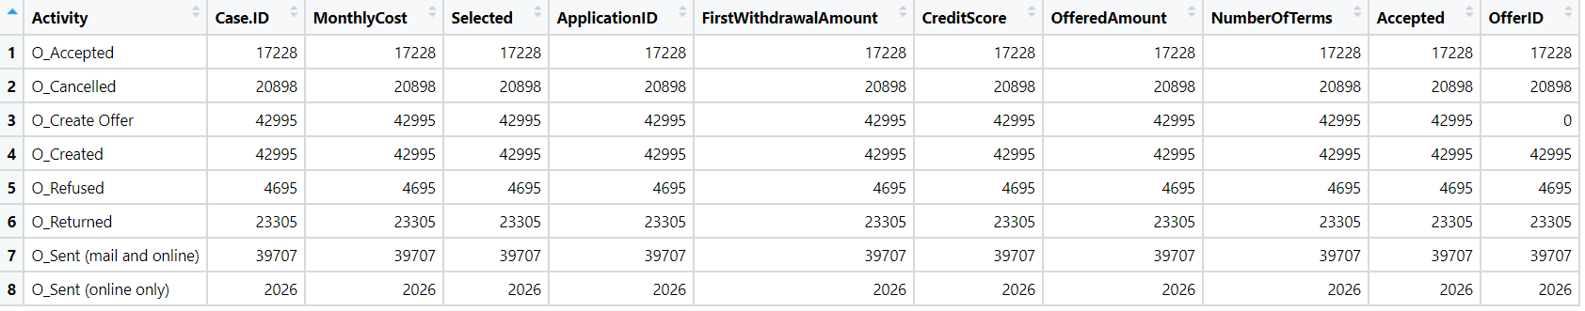
Offers – A2A Matrix

Slide 23
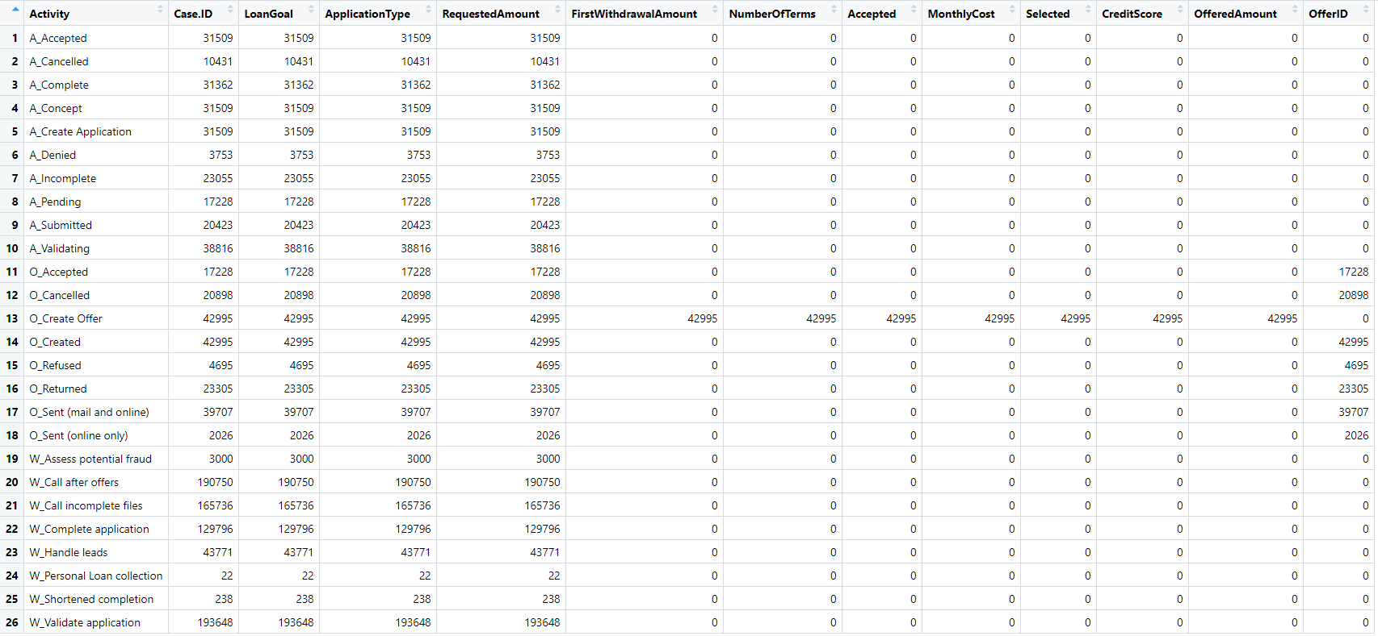
OfferApplications – A2A Matrix

Slide 24
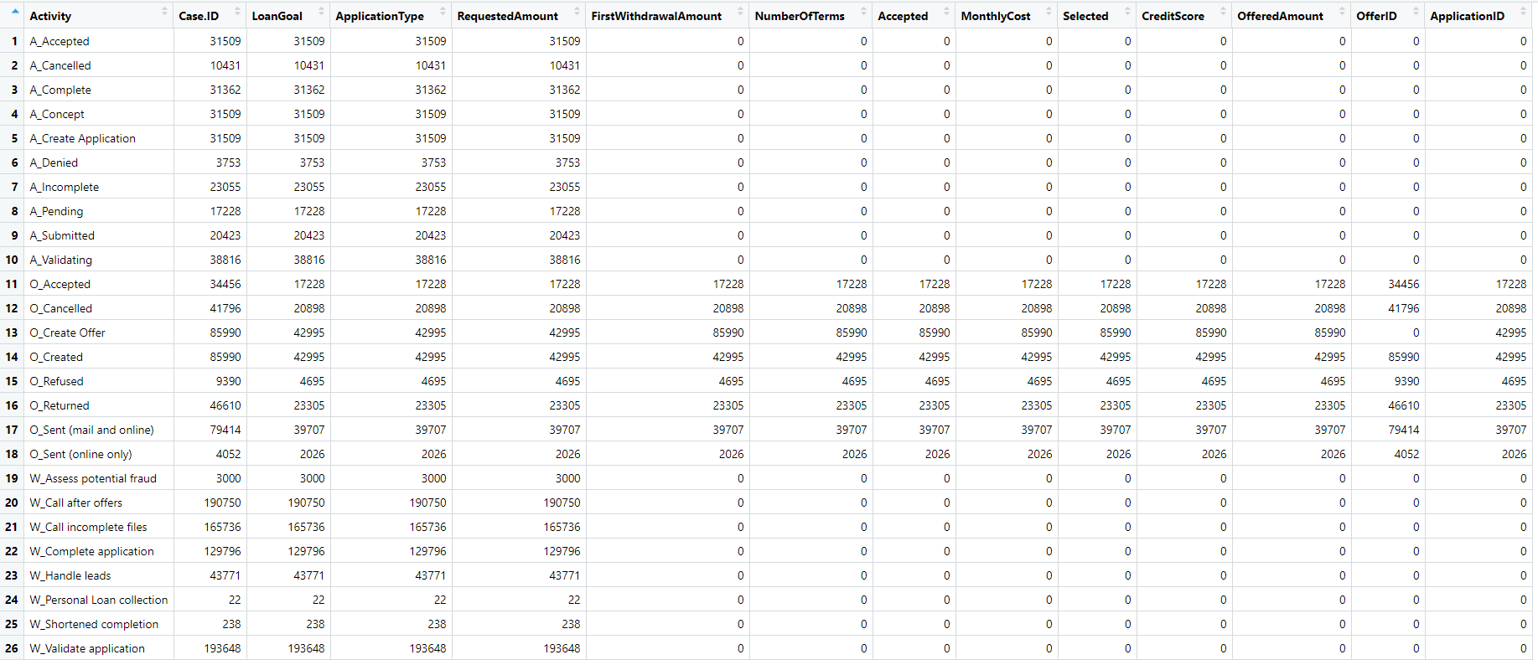
Union(OfferApplications, Offers) – A2A Matrix

Slide 25
New Rule: Multilog Access
„Each set of cells accessed by multiple event logs is treated as representing the same data model class.“

Slide 26
New Rule: Multilog Access
„Each set of cells accessed by multiple event logs is treated as accessed by the same data model class.“
C1
Case.ID
FirstWithdrawalAmount
NumberOfTerms
Accepted
MonthlyCost
Selected
CreditScore
OfferedAmount
OfferID

Slide 27
New Definition: Fully Connected A2A
„A2A diagram/matrix in which all activities access all attributes“
Att1
 | Att1 | Att2 | Att3
A | x | y | z
B | x | y | x
C | x | x | y
A
Att2
B
Att3
C
Att4

Slide 28
New Definition: Partially Fully Connected A2A
„A2A diagrams / matrices in which a subset of activities always accesses a subset of attributes“
Att1
 | Att1 | Att2 | Att3 | Att4
A | x | y | z | 0
B | x | x | x | 0
C | x | x | x | 0
D | 0 | 0 | 0 | y
A
Att2
B
Att3
C
Att4
D
Att5

Slide 29
New Rule: (Partially) Fully Connected A2A
Attributes belonging to partially fully connected a2a subsets are treated as belonging to one data class
c1
Case.ID
FirstWithdrawalAmount
NumberOfTerms
Accepted
MonthlyCost
Selected
CreditScore
OfferedAmount
OfferID
c2
LoanGoal
ApplicationType
RequestedAmount
ApplicationId

Slide 30
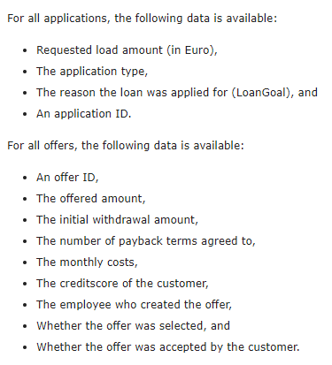
BPI 2017 Challenge Data Definition vs. Result
https://www.win.tue.nl/bpi/doku.php?id=2017:challenge
c2
LoanGoal
ApplicationType
RequestedAmount
ApplicationId
c1
Case.ID
FirstWithdrawalAmount
NumberOfTerms
Accepted
MonthlyCost
Selected
CreditScore
OfferedAmount
OfferID

Slide 31
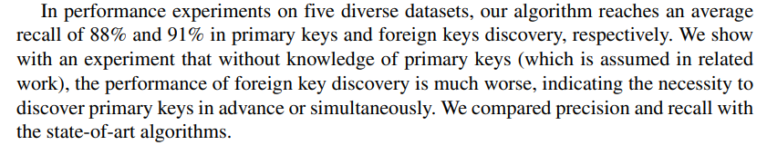
Limitation - Key Matching
c1
Case.ID
FirstWithdrawalAmount
NumberOfTerms
Accepted
MonthlyCost
Selected
CreditScore
OfferedAmount
OfferID
c2
LoanGoal
ApplicationType
RequestedAmount
ApplicationId
Jiang, L., Naumann, F. Holistic primary key and foreign key detection. J Intell Inf Syst 54, 439–461 (2020)

Slide 32
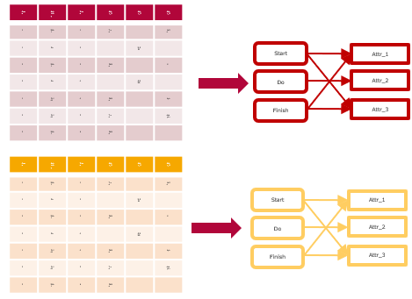
Proposed Algorithm
A2A for all EL
Multilog-Rule + Combine (Union)
Fully Connected Rule
Rules 1-4 as normal

Slide 33
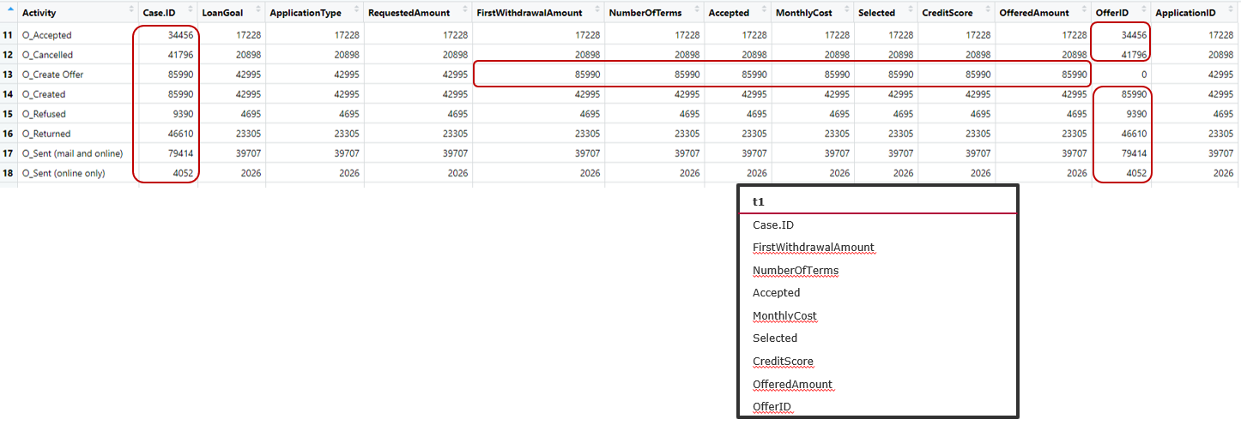
Proposed Algorithm
A2A for all EL
Multilog-Rule + Combine (Union)
Fully Connected Rule
Rules 1-4 as normal

Slide 34
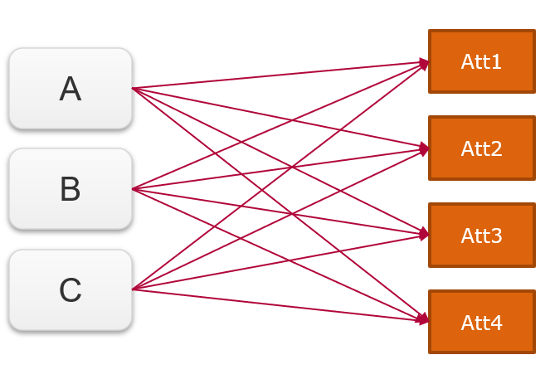
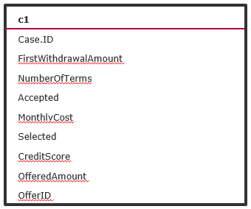
Proposed Algorithm
A2A for all EL
Multilog-Rule + Combine (Union)
Fully Connected Rule
Rules 1-4 as normal

Slide 35
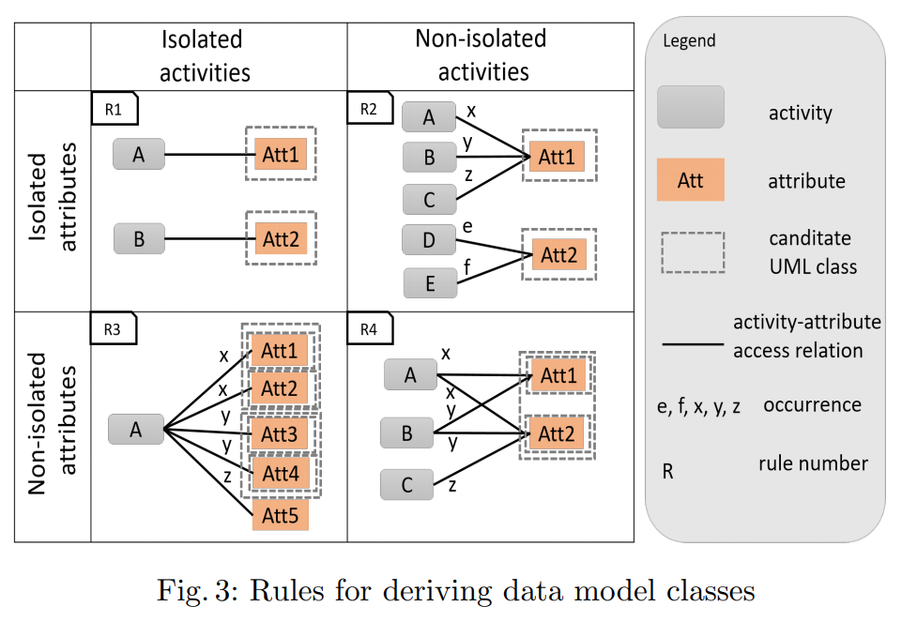
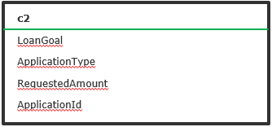
Proposed Algorithm
A2A for all EL
Multilog-Rule + Combine (Union)
Fully Connected Rule
Rules 1-4 as normal

Slide 36

Proposed Algorithm
A2A for all EL
Multilog-Rule + Combine (Union)
Fully Connected Rule
Rules 1-4 as normal

Slide 37
Dataset Overview – BPI Challenge 2020
Dataset of five event logs
Permits: 86581 events, 170 attributes
DomesticDeclarations: 56437 events, 7 attributes
InternationalDeclarations: 72151 events, 20 attributes
PrepaidTravelCost: 18246 events, 19 attributes
RequestForPayment: 36796 events, 11 attributes

Slide 38
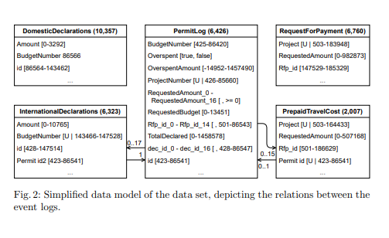
Dataset Overview – BPI Challenge 2020
Dorina Bano , Maximilian Volker , Simon Remy , Henrik Leopold , and Mathias Weske. (2020).
Multi-perspective Analysis of Approval Processes based on Multiple Event Logs

Slide 39
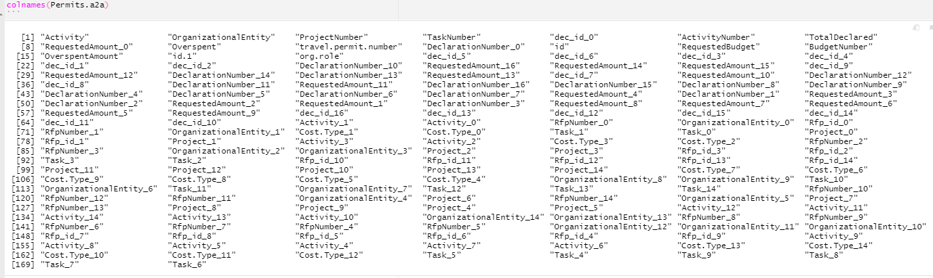
Dataset Overview – BPI Challenge 2020
0 – Not accepted. Major revisions needed.

Slide 40
BPI Challenge 2020 – Simplified
„Preprocess“ using attributes from Bano et. al model
How close can we get to the model?
Dorina Bano , Maximilian Volker , Simon Remy , Henrik Leopold , and Mathias Weske. (2020).
Multi-perspective Analysis of Approval Processes based on Multiple Event Logs

Slide 41
Simplified Approach
Multilog Access Rule
Fully Connected Rule
No attributes left to assign
C1
Amount
BudgetNumber
id
C2
Project
RequestedAmount
Rfp_id
(from InternationalDeclarations + DomesticDeclarations)
(from RequestForPayment + PrepaidTravelCost)
C3
Overspent
OverspentAmount
ProjectNumber
RequestedBudget
TotalDeclared
(from full union)

Slide 42
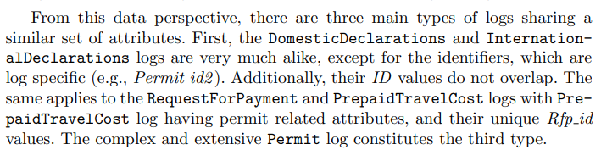
Simplified Approach – Result vs. Bano et. al
C3
Overspent
OverspentAmount
ProjectNumber
RequestedBudget
TotalDeclared
C1
Amount
BudgetNumber
id
C2
Project
RequestedAmount
Rfp_id

Slide 43
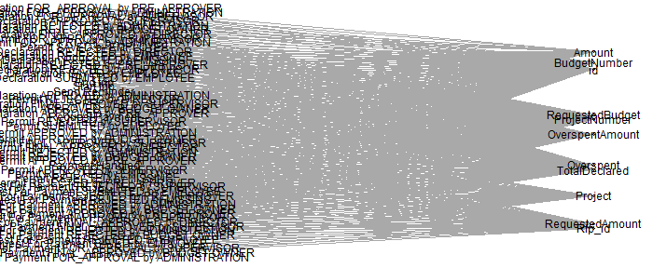
Backwards Approach - Result vs. Graphing Library
C3
Overspent
OverspentAmount
ProjectNumber
RequestedBudget
TotalDeclared
C1
Amount
BudgetNumber
id
C2
Project
RequestedAmount
Rfp_id

Slide 44
Backwards Approach - Result vs. Graphing Library
C3
Overspent
OverspentAmount
ProjectNumber
RequestedBudget
TotalDeclared
C1
Amount
BudgetNumber
id
C2
Project
RequestedAmount
Rfp_id

Slide 45
Discussion
Assumption: Consistent naming of attributes
Interesting results for BPI Challenge datasets 2017 and 2020
BUT new rules might be overfitted
Often one sparse „main“ log
Secondary event logs fully connected
Just take any fully connected event log as one DM class?
Are there different classes of fully connectedness?
Is there auxilliary informaton to identify keys?

Slide 46

Thank you!
Kim-Pascal Borchart
BPI @ HPI
Summer 2021

Slide 47
Recap - Approach – „Naive“
1
Attr_1 Attr_3
Case | Activity | Time | Attr_1 | Attr_2 | Attr_3
1 | Start | 1 | True |  | hello
1 | Do | 2 |  | 9.001
2 | Start | 3 | False |  | hi
2 | Do | 4 |  | 8.999
1 | Finish | 4 | False |  | bye
2 | Finish | 5 | True |  | see you
3 | Start | 6 | False
1
Attr_1 Attr_3
Start
Attr_1
2
Attr_2
Do
Attr_2
2
Attr_2
Finish
Attr_3
N
Attr_n-2 Attr_n-1 Attr_n
N-1
Attr_n-2 Attr_n-1 Attr_n
Case | Activity | Time | Attr_1 | Attr_2 | Attr_3
1 | Start | 1 | True |  | hello
1 | Do | 2 |  | 9.001
2 | Start | 3 | False |  | hi
2 | Do | 4 |  | 8.999
1 | Finish | 4 | False |  | bye
2 | Finish | 5 | True |  | see you
3 | Start | 6 | False
N
Attr_n-2 Attr_n-1 Attr_n
Start
Attr_1
Do
Attr_2
N
Attr_n-2 Attr_n-1 Attr_n
Finish
Attr_3

Slide 48
Recap – Approach – „Naive“ v2
Case | Activity | Time | Attr_1 | Attr_2 | Attr_3
1 | Start | 1 | True |  | hello
1 | Do | 2 |  | 9.001
2 | Start | 3 | False |  | hi
2 | Do | 4 |  | 8.999
1 | Finish | 4 | False |  | bye
2 | Finish | 5 | True |  | see you
3 | Start | 6 | False
Case | Activity | Time | Attr_1 | Attr_2 | Attr_3
1 | Start | 1 | True |  | hello
1 | Do | 2 |  | 9.001
2 | Start | 3 | False |  | hi
2 | Do | 4 |  | 8.999
1 | Finish | 4 | False |  | bye
2 | Finish | 5 | True |  | see you
3 | Start | 6 | False
1
Attr_1 Attr_3
Start
Attr_1
2
Attr_2
 |  |  | Case | Activity | Time | Attr_1 | Attr_2 | Attr_3
 |  |  | 1 | Start | 1 | True |  | hello
 |  |  | 1 | Do | 2 |  | 9.001
 |  |  | 2 | Start | 3 | False |  | hi
 |  |  | 2 | Do | 4 |  | 8.999
 |  |  | 1 | Finish | 4 | False |  | bye
 |  |  | 2 | Finish | 5 | True |  | see you
 |  |  | 3 | Start | 6 | False
Do
Attr_2
Case | Activity | Time | Attr_1 | Attr_2 | Attr_3
1 | Start | 1 | True |  | hello
1 | Do | 2 |  | 9.001
2 | Start | 3 | False |  | hi
2 | Do | 4 |  | 8.999
1 | Finish | 4 | False |  | bye
2 | Finish | 5 | True |  | see you
3 | Start | 6 | False
Finish
Attr_3
N
Attr_n-2 Attr_n-1 Attr_n

Slide 49
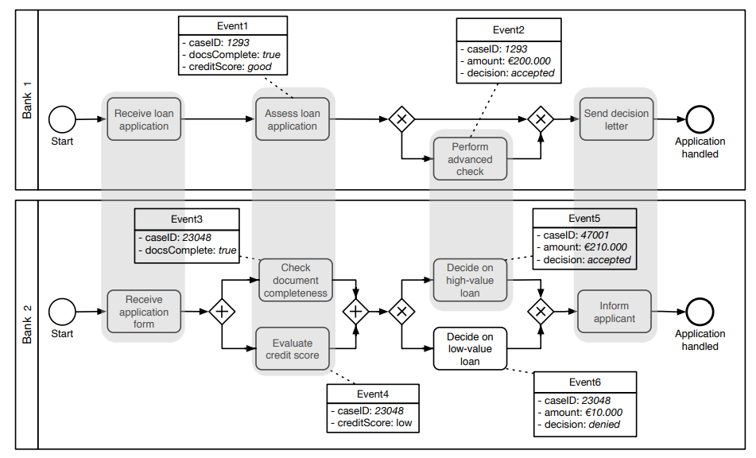
Related Work (from Intermediate Presentation) – Schema Matching on Event Logs
van der Aa, Han & Gal, Avigdor & Leopold, Henrik & Reijers, Hajo & Sagi, Tomer & Shraga, Roee. (2017). Instance-Based Process Matching Using Event-Log Information.
Instance-based approach
Attribute Name Similarity
Attribute Value Similarity
Occurrence Similarity (frequency)
Additional process-related metrics:
Positional Similarity
Duration Similarity
Prerequisites Similarity

Slide 50
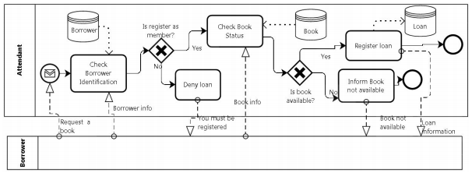
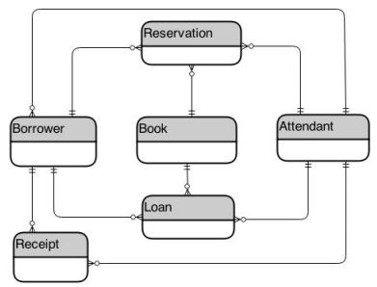
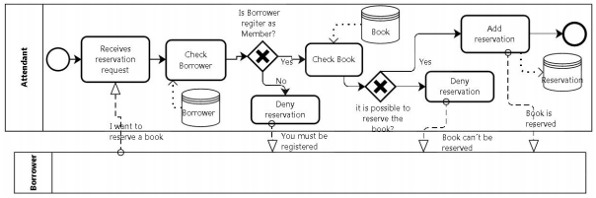
Related Work (from Intermediate Presentation) – Deriving Data Model from Related BPMs
Cruz, Estrela & Machado, Ricardo-J & Santos, Maribel. (2015). Deriving a Data Model from a Set of Interrelated Business Process Models.

Slide 51
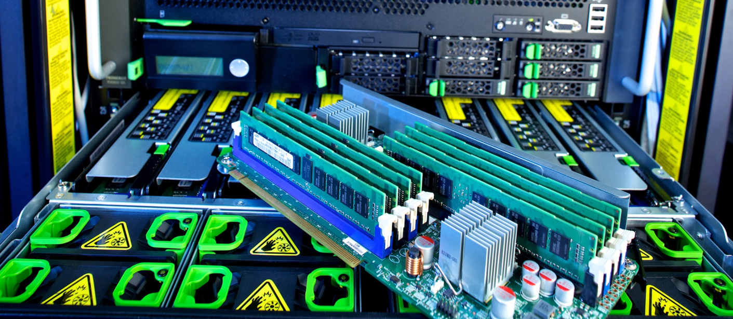

Slide 52


Slide 53
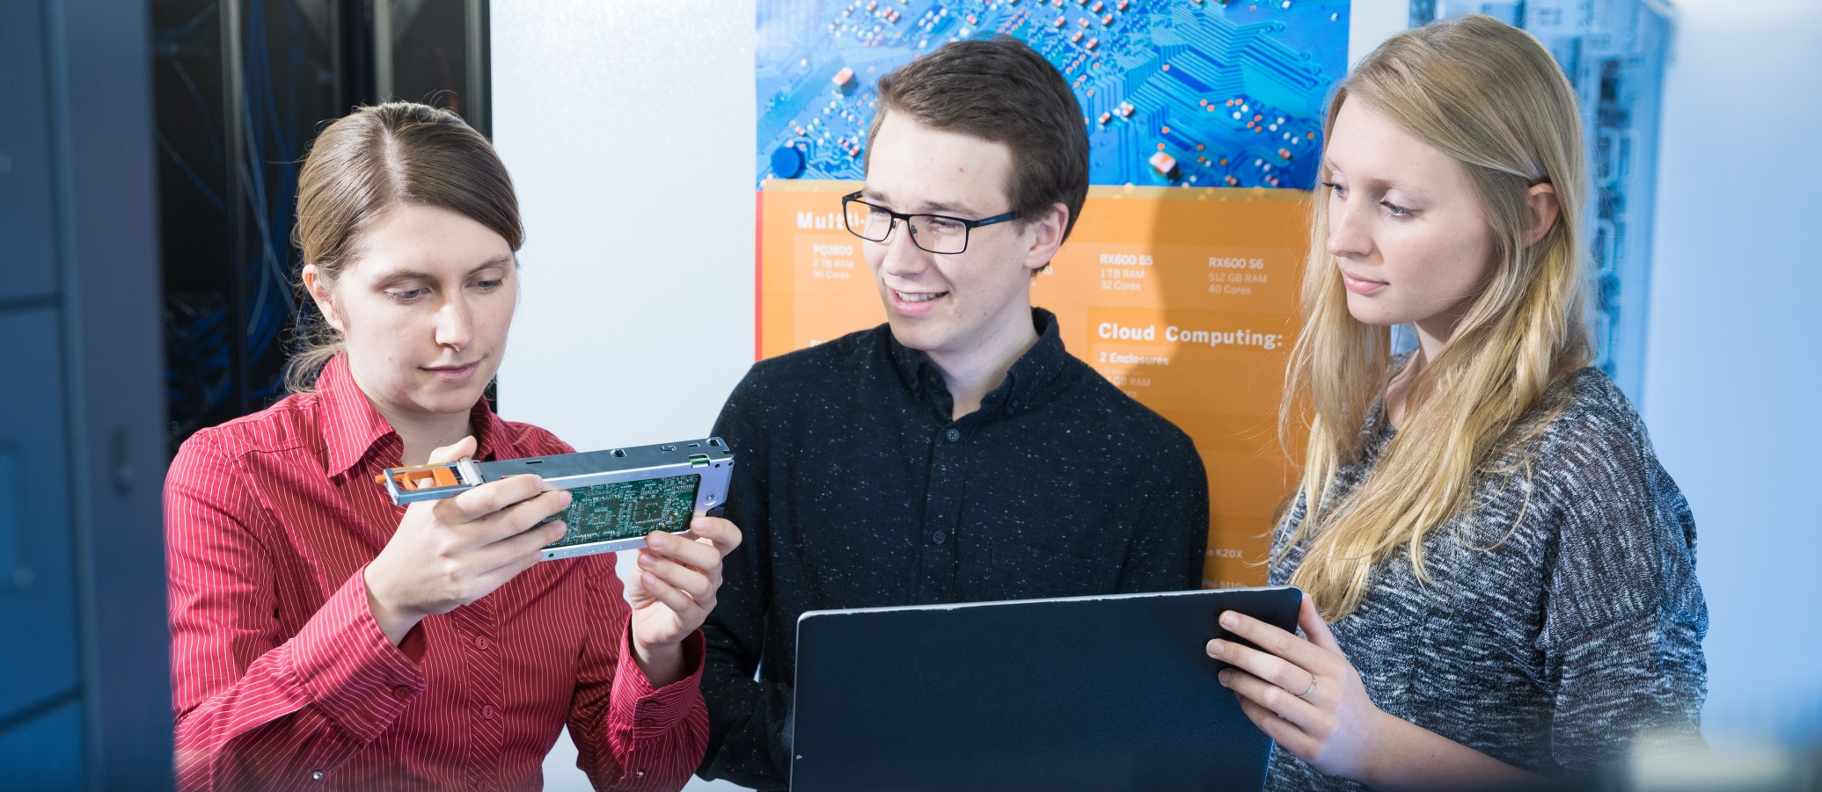

Slide 54

Explanations - Text layers
First text layer for running text.
Second level for bullet points
Third level for bullet points
Fourth level for bullet points
Fifth level for numberings
Sixth level for listings
Seventh text layer for Core Messages
In this template, we pre-formatted different text layers (as you can see on the right side). You don’t have to generate bullet points manually. By the way: Please avoid this!
To change from one text layer to the next, use the Increase / Decrease List Level buttons:

Slide 55

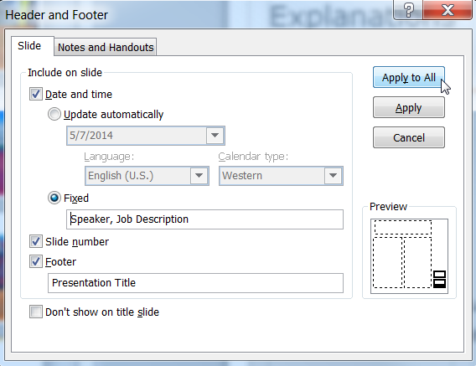
Explanations - Footer
You can insert or change your presentation‘s footer. Click on the Insert-tab | Header and Footer | After filling in your descriptions click on Apply to All.
Descriptions:
Activate date and time and write in:Speaker, Job Description
Activate the slide number.
Activate the footer and write in: Presentation Title
Don‘t use the template without the complete footer.

Slide 56
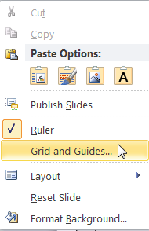
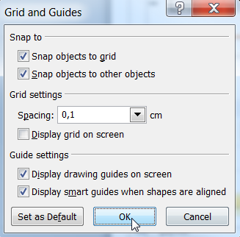
Explanations - Drawing guides
You can enable your guide-lines to align objects on the slide (View | Show | Select the option „Guides“)
Or hit the right mouse button outside the slide and go at „Grid and Guides…“

Slide 57
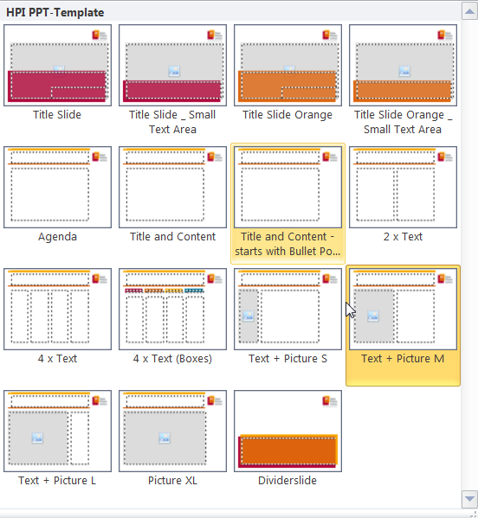
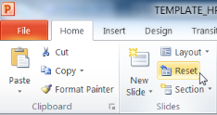
Explanations - Slide layouts
You can choose between different slide layouts. These pre-defined layouts gives you the oportunity to use text and visualisations just the right way.
To use these layouts:
Click on the Home-tab | New Slide or Layout | and choose one out of the layouts
Click „Reset“ to reset to the predefined slide layout.

